Slide 1
INVESTMENT CASE STUDY SUBMISSION
Member name:
Naveen Bharadwaj N

Slide 2
Abstract
Help Spark Investment firm to make data driven investments on different sectors
Approach to data transformation/cleansing
Approach to problem solving
Analysis methods
Solution graphs

Slide 3
Approach to data transformation/cleansing
Companies
Permalink
Master Frame
Venture Frame
Decide best funding type
Rounds2
Company Permalink

Slide 4
Analysis methods
Identified a dataframe of suitable Funding type
Identify suitable funding type based on the trend seen in the merged data (master_frame)
Filter investments only between 5 million and 15 million since that’s the limit of Spark Foundations budget
Sort countries in descending order on total investments made
Consider the first 3 countries for practical purposes
Identify the sector that the company belongs to in the master frame
Use the mapping data available
Impute the missing values with “Blank” in the mapping sheet to maintain uniformity
Associate the primary sector to its respective Main Sector in the newly merged data
Identify the sectors in the top 3 countries where the highest investments are being made
Use the information : Total money raised by Main Sector in Top 3 countries
Finally Identify the company in each sector of each country that’s been getting maximum funding to guide Spark Foundations to invest their funds

Slide 5
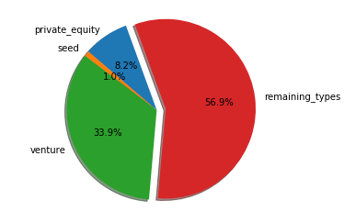
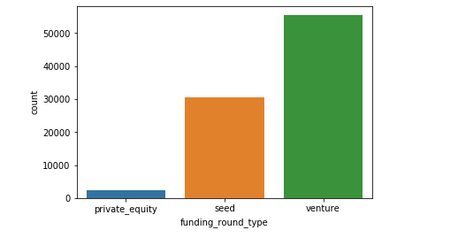
Solution graphs : Plot 1
Fraction of total investments Average amount of investment

Slide 6
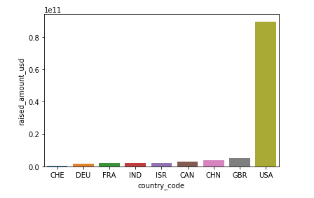
Plot 2
A plot showing the top 9 countries against the total amount of investments on Venture Type

Slide 7
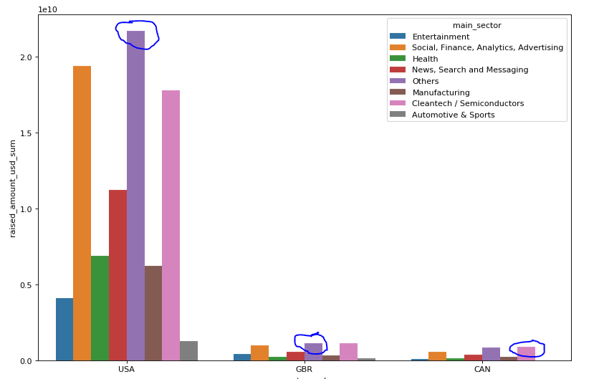
Plot 3
A plot showing investment sectors in Top 3 countries

